Slide 1
Age and Gender Prediction
Jakkaphob Kongthanarith 6210554725

Slide 2
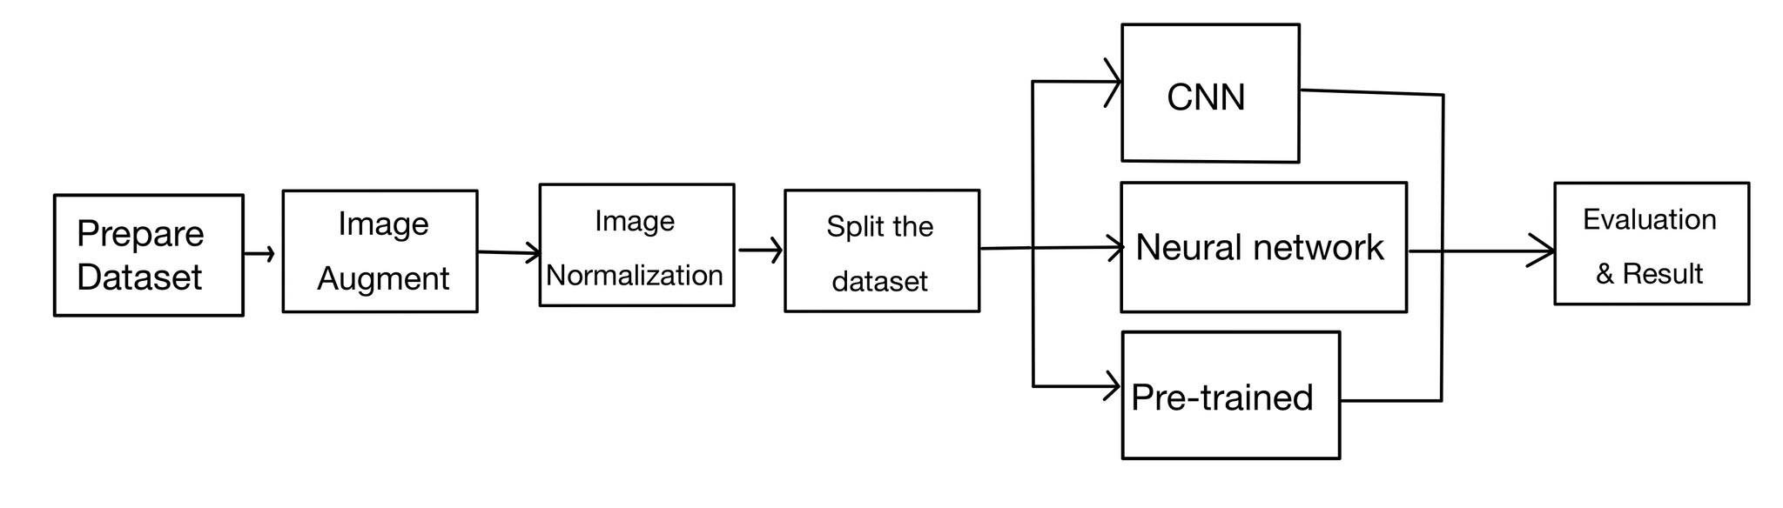
Flow Chart
Age and Gender Combine model

Slide 3
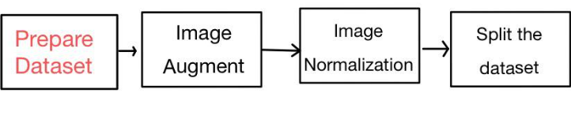
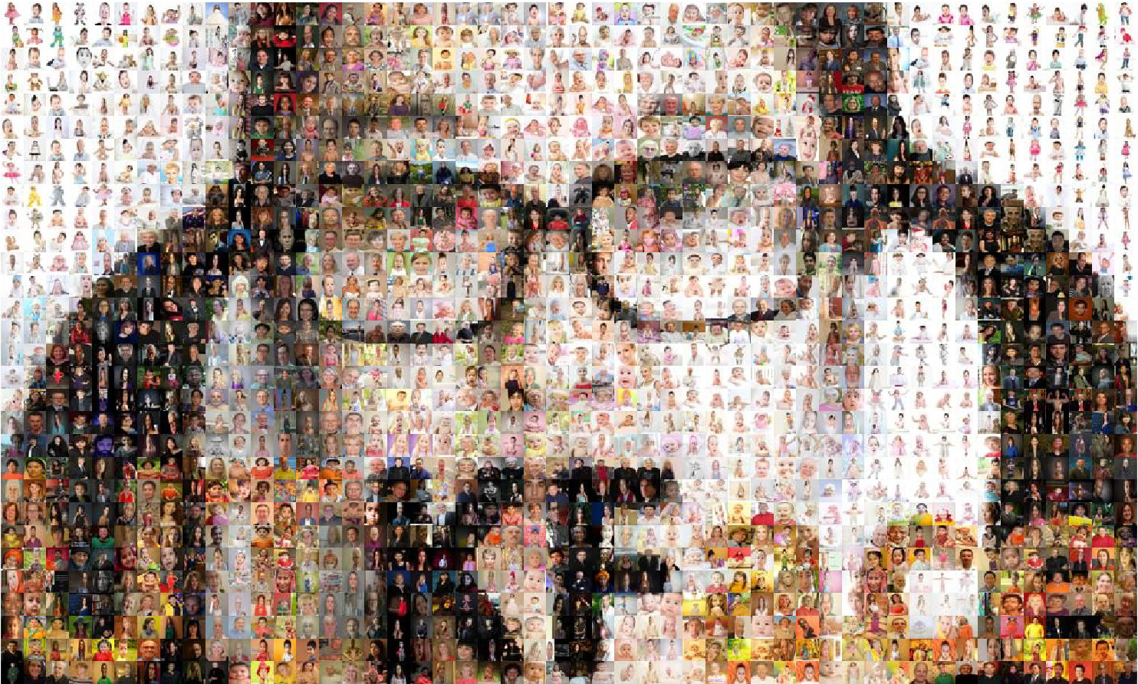

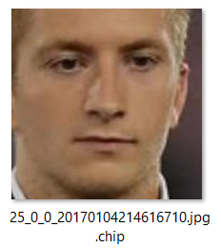
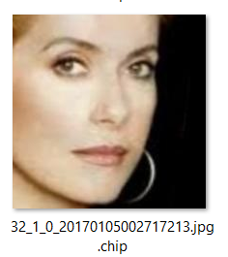
Data sets
Number of files per gender: 25
Age range: 1-79
UTK Face downloaded from Kaggle
Content: Face images
Age range: 0 to 116
Gender: Male and Female
Number of images : 23,708 images
Age_Gender_Ethnicity_Filename.jpg.chip.jpg
https://www.kaggle.com/datasets/jangedoo/utkface-new
Age = 25
Gender = 0 -> Male
Age = 32
Gender = 1 -> Female
Source: https://susanqq.github.io/UTKFace/.
https://www.iconfinder.com/icons/4373210/kaggle_logo_logos_icon

Slide 4
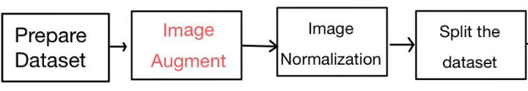
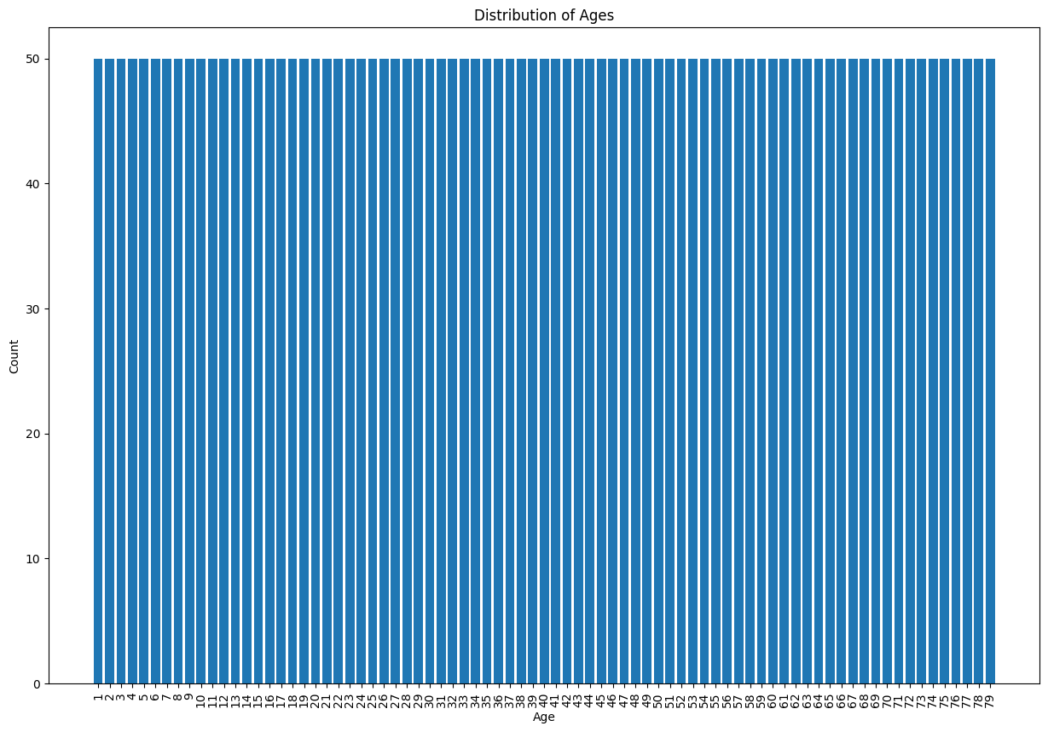
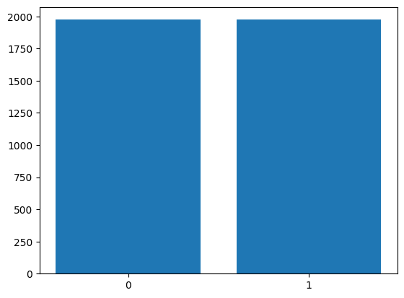
Image Augmentation
If the number of Images for each gender did not reach the maximum count (25) perform an augmentation
Augmentation method: Enhance contrast, brightness
Total Samples: 3950
0 = Male | 1 = Female
Min Value = 1 | Max value = 79

Slide 5
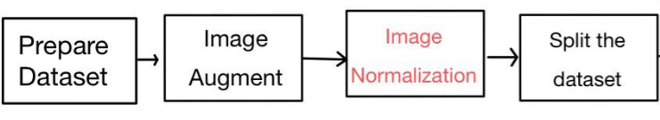


Image Normalization
Normalize the image to be used for Dataset’s features by divide all of pixel values by 255
Faster processing time
better accuracy
A part of pixel values before
Normalization
A part of pixel values After
Normalization

Slide 6
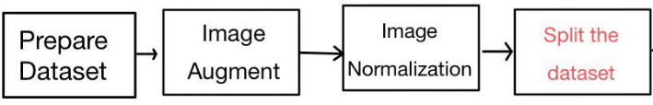
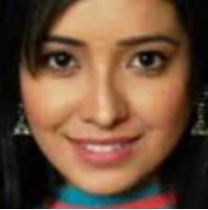

Dataset for Model training
Total images: 3950
Split into Training and Testing Dataset
Train: 3160
Test: 790
Data type: numpy.ndarray
x train
(Image of an individual person)
y train
(Age of an individual person)
Actual age: 21
Actual age: 46

Slide 7
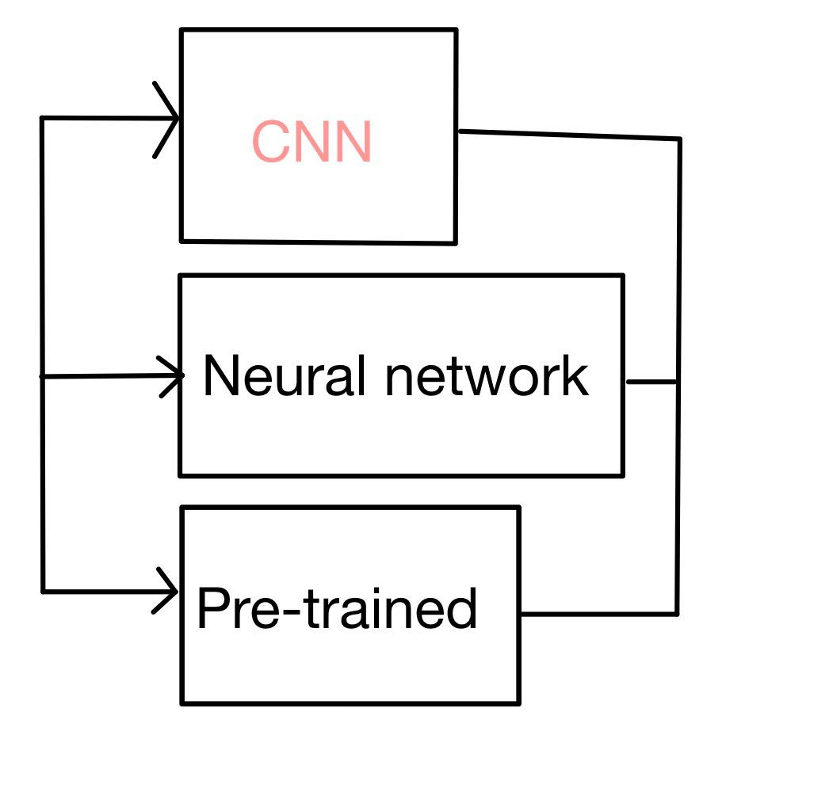
Age and Gender Model (CNN)
Age Model
Input layer : (224,224,1)
Output layer : ReLU
Epoch = 100
Batch size = 80
Gender Model
Input layer : (224,224,1)
Output layer : Sigmoid
Conv2D Layer : 32>64>128
Age Layer : 128>64>32>1
Gender Layer : 128>64>32>16>8>1
= Input
= Convolutional2D
= Max Pooling
= Dropout
= Flatten
= Dense with ReLU
= Output
Age Model
Gender Model

Slide 8
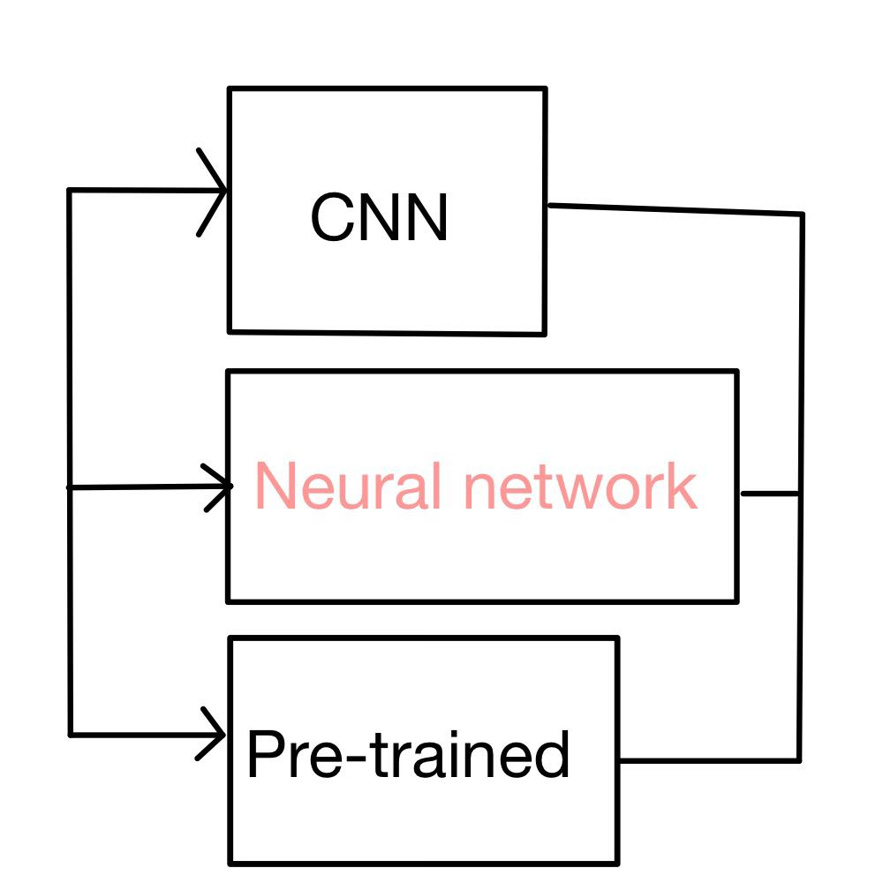
Age and Gender Model (Neural Network)
Age Model
Input layer : (224,224,1)
Output layer : Linear
Gender Model
Input layer : (224,224,1)
Output layer : Sigmoid
Epoch = 60
Batch size = 32
Age Dense: 128>64>1
= Input
= Dropout
= Flatten
= Dense with ReLU
= Output
Gender Dense: 128>64>1

Slide 9
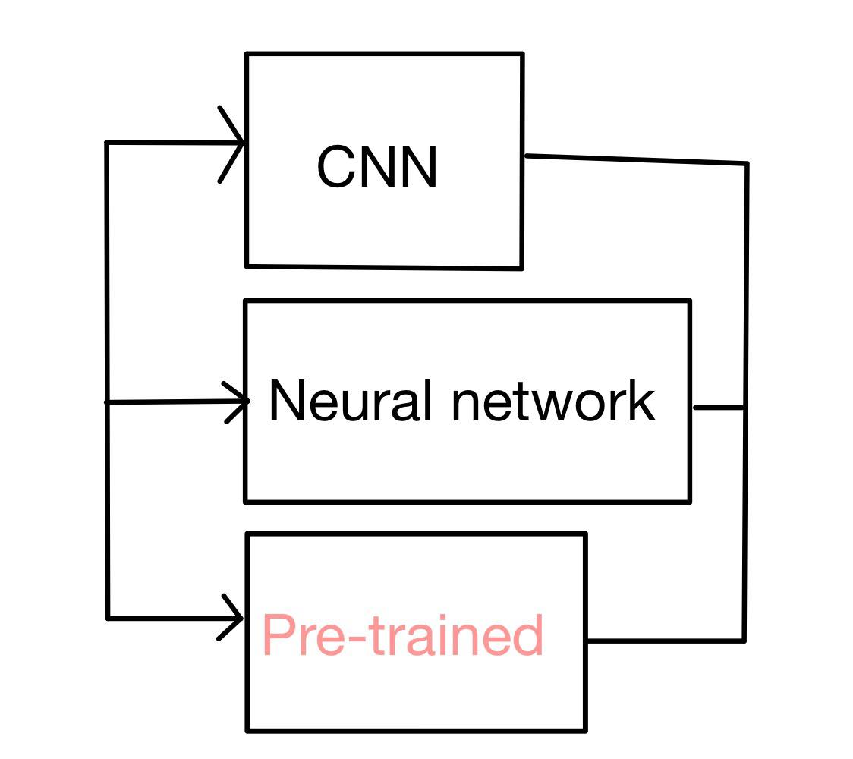
Age and Gender Model (Pretrained+Finetuned)
Age Model
Input layer : (224,224,3)
Output layer : ReLU
Gender Model
Input layer : (224,224,3)
Output layer : Sigmoid
Epoch = 100
Batch size = 128
Age Layer : 128>64>1
= Pretrained model output
= Dropout
= Batch Normalization
= Flatten
= Dense with ReLU
= Output
Gender Layer : 256>128>1

Slide 10
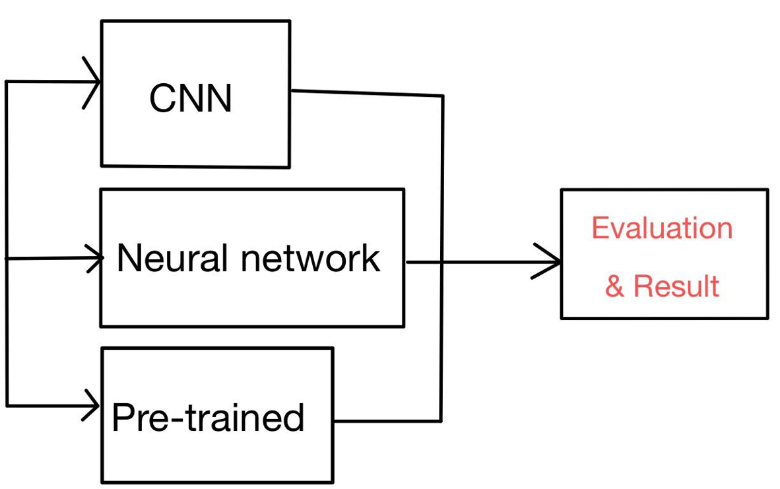
Age Model Evaluation
Model | Train MAE | Test MAE | Train Loss | Test Loss
CNN | 10.5386 | 15.1492 | 197.7404 | 357.4378
Neural Network | 18.4853 | 17.1355 | 484.3796 | 406.8231
VGG 16 Pretrained + fine-tuning model | 7.4472 | 9.9541 | 95.2519 | 164.0147

Slide 11
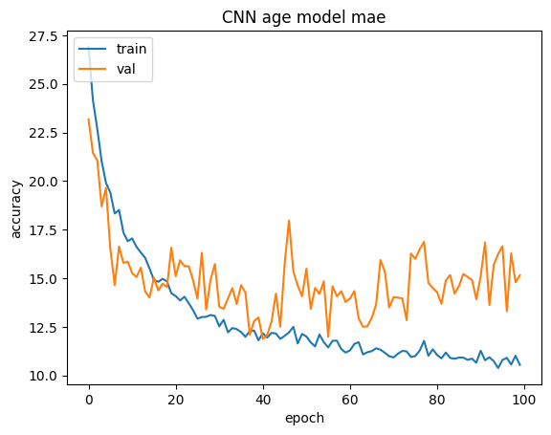
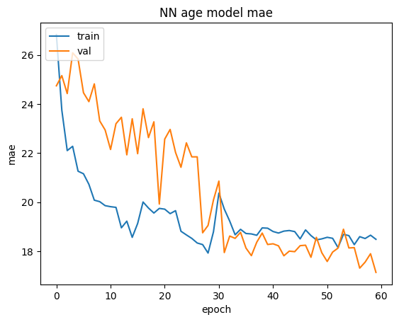
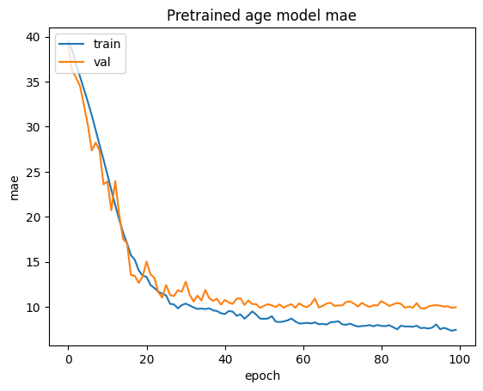
Age Model Evaluation Graph

Slide 12

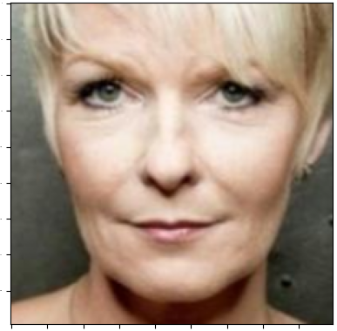
Percentage error of the model
def error_count(error):
error1 = 0
error2 = 0
error3 = 0
error4 = 0
if error < 5:
error1 = error1+1
elif error <= 10:
error2 = error2+1
elif error <= 15:
error3 = error3+1
elif error > 15:
error4 = error4+1
return error1,error2,error3,error4
percent_dif = (abs(predicted_age – actual_age))/ max_age) * 100
error_count(percent_dif)
Real | Predict
76 | 47
percent difference: 32 %
Real | Predict
44 | 40
percent difference: 4 %

Slide 13
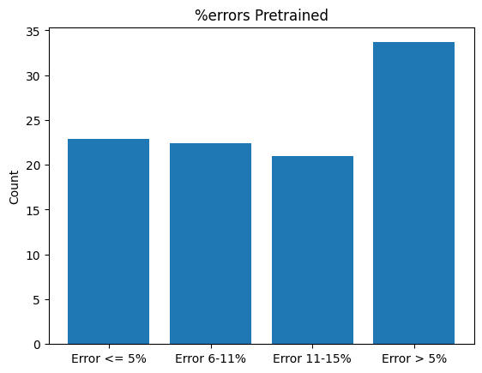
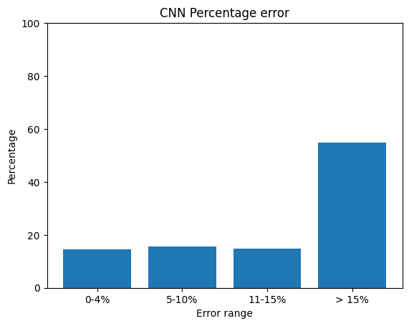
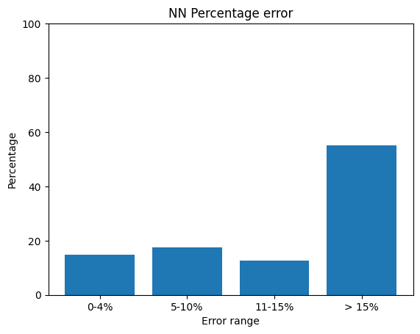
Distribution of percent error
Test size: 400 files Randomly selected from UTK Face Dataset
Error <5 %: 14.56 %
Error between 6- 10%: 15.70 %
Error between 11-15%: 14.94 %
Error > 15%: 54.81 %
Error <5 %: 14.81
Error between 6- 10%: 17.47 %
Error between 11-15%: 12.53 %
Error > 15%: 55.19 %
Error < 5 %: 22.91 %
Error between 6- 10%: 22.41 %
Error between 11-15%: 21.01 %
Error > 15%: 33.67 %

Slide 14
Gender Model Evaluation
Model | Train Accuracy | Test Accuracy | Train Loss | Test Loss
CNN | 0.8513 | 0.8468 | 0.3507 | 1.5800
Neural Network | 0.8256 | 0.7709 | 0.3805 | 0.4442
VGG-16 Pre-trained model + fine-tuning model | 0.8570 | 0.8494 | 0.2017 | 0.7013

Slide 15
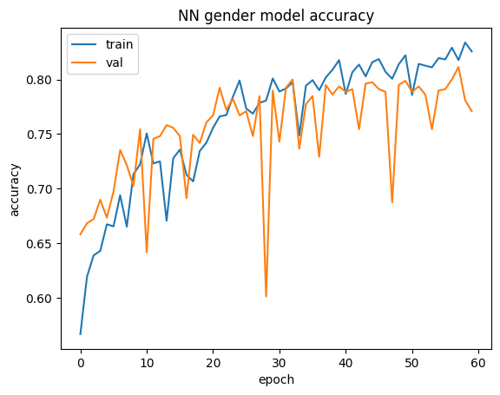
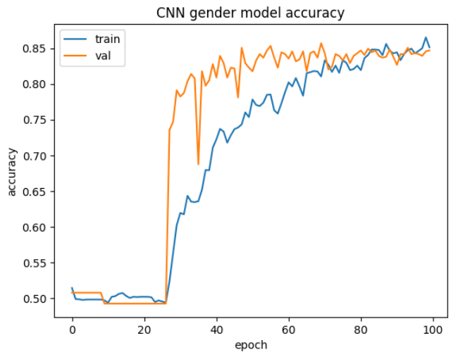

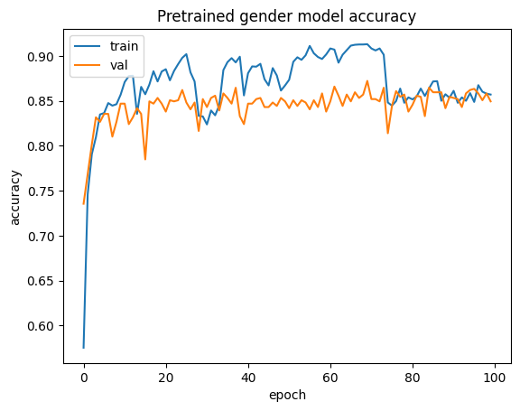
Gender model Accuracy Graph

Slide 16
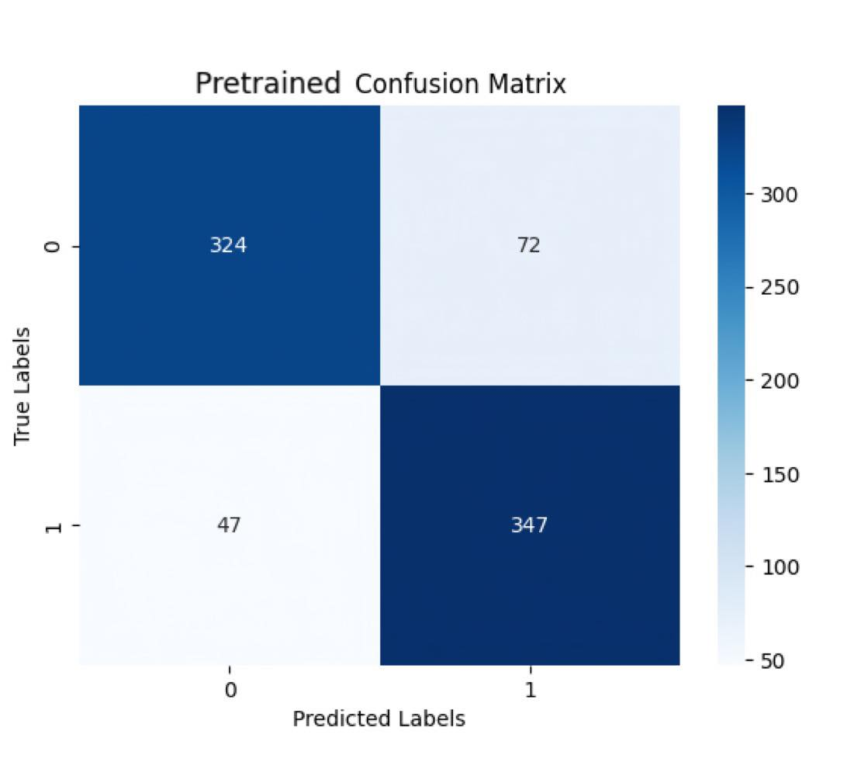
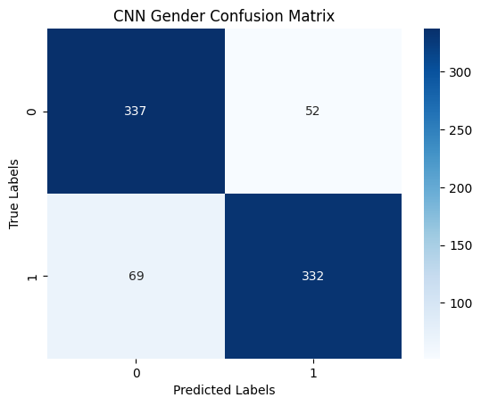
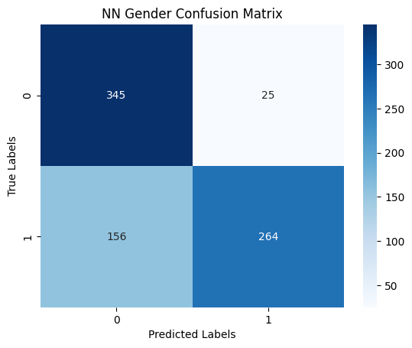
Gender Model Confusion Matrix

Slide 17
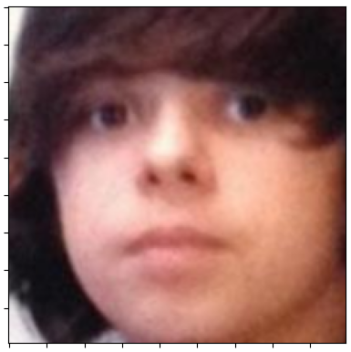
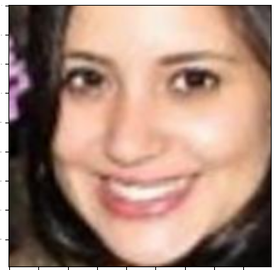
Gender Prediction
def get_gender(prob):
if prob < 0.5:return "Male"
else: return "Female"
- A model make a prediction value of the selected image
- Function ‘get_gender()’ will check that the value is higher or lower than 0.5
- If the predicted value lover than 0.5, return ‘male’ as an outcome
- Otherwise, return ‘female’ as an outcome
Real | Predict
Male | Male
Prediction Value 0.253399
Real | Predict
Female | Female
Prediction Value 0.999868

Slide 18




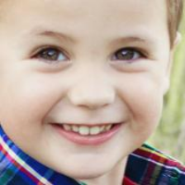
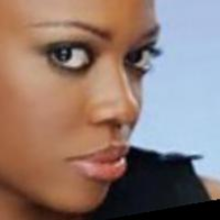
Prediction Result
Real age | Predict age
61 | 56
Real gender | Predict gender
Male | Male
Real age | Predict age
25 | 32
Real gender | Predict gender
Female | Female
Real age | Predict age
12 | 1
Real gender | Predict gender
Male | Male
Real age | Predict age
12 | 31
Real gender | Predict gender
Female | Female
Real age | Predict age
4 | 12
Real gender | Predict gender
Male | Female
Real age | Predict age
26 | 18
Real gender | Predict gender
Female | Male

